Slide 1



Irobot ii
Creating garden monitoring device
Prepared by: engr. Ronchester sigfrid mendoza

Slide 2

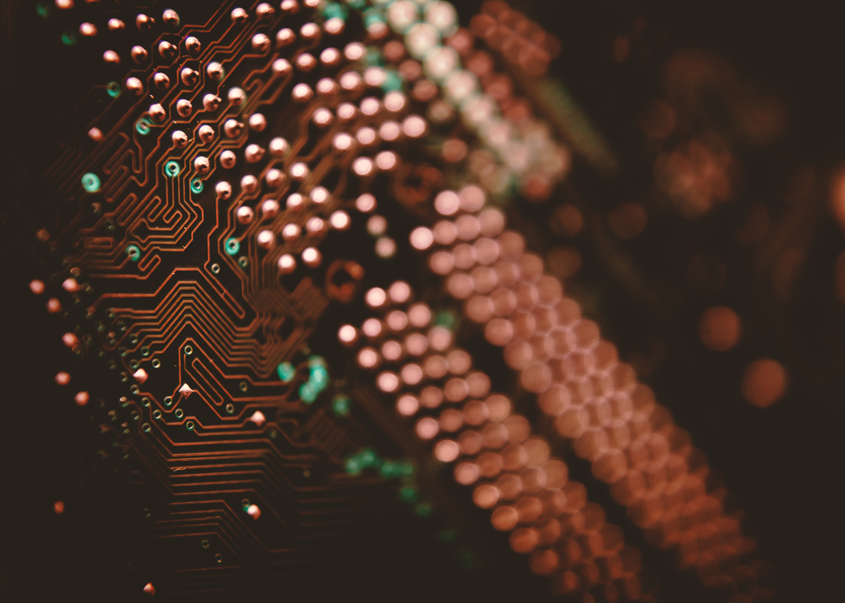
Components
POWER SUPPLY
LCD SCREEN
SENSORS
PROCESSOR

Slide 3
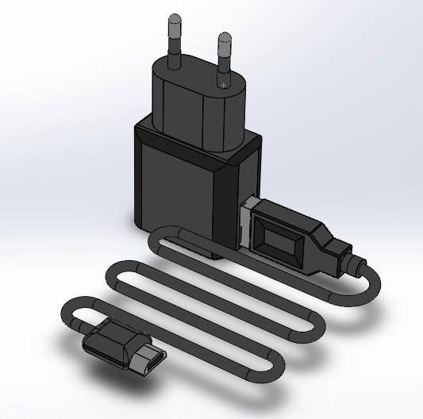
POWER SUPPLY
A power supply is an electrical device that supplies electric power to an electrical load
The primary function of a power supply is to convert electric current from a source to the correct voltage, current, and frequency to power the load
Typical 5V power supply

Slide 4
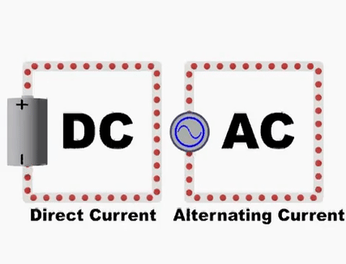
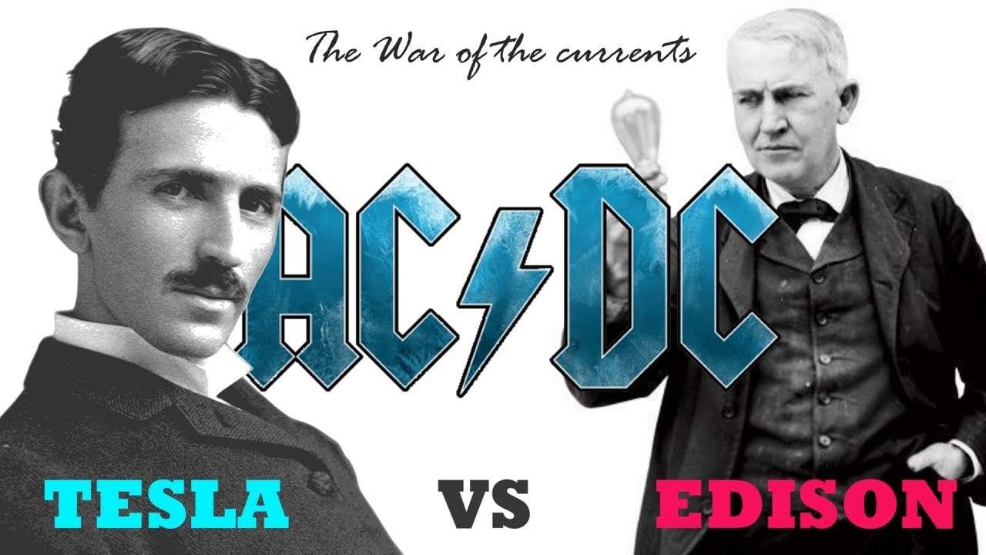
War of the Currents
Both AC and DC describe types of current flow in a circuit.
In direct current (DC), the electric charge (current) only flows in one direction.
Electric charge in alternating current (AC), on the other hand, changes direction periodically.
Notes:
History
Tesla is a former employee of DC creator, Thomas Edison in 1890
Tesla patented AC as new form of current
Edisons company was threathened when Tesla solds his patents to Westinghouse, a business investor, in order to create a Americas new grid
As attempt to overthrew the AC idea to the public, Edison produces stunts such as using AC to electrocute stray dogs, an Elephant, and produce the 1st victim of Electric Chair
But this didn’t stop the 2 partners. They won a bid to produce a large scale power grid. A literal waterfall landslide loss to Edison. Westinghouse build the power grid generator in Niagra Falls
which provides almost 50% of America

Slide 5
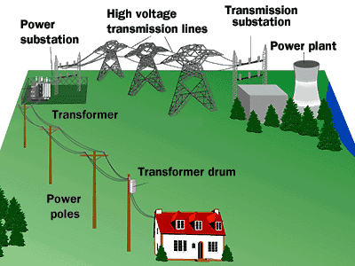
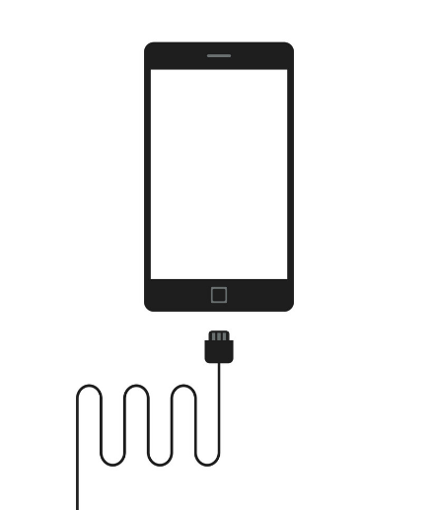
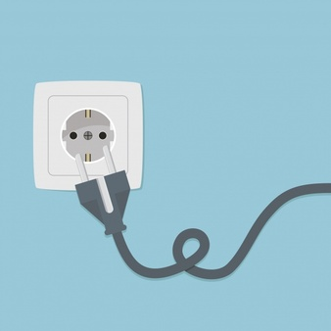

USE OF DC AND AC
Most of the digital electronics that you use will use DC.
AC also has some useful properties, such as being able to convert voltage levels with a single component (a transformer), which is why AC was chosen as the primary means to transmit electricity over long distances.

Slide 6
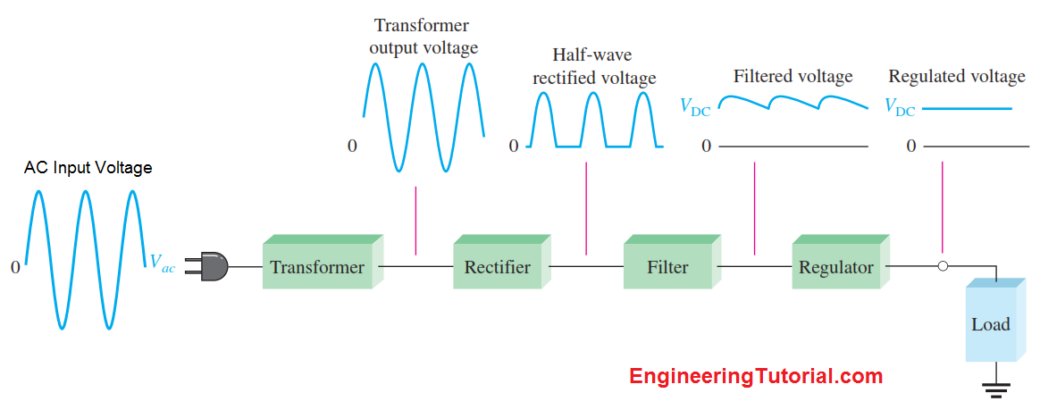
Converting AC to DC
Transformers steps down the voltage input based on turns ratio of primary and secondary
Rectifiers converts AC input voltage to pulsating DC voltage
Filters eliminates fluctuations and tries to produce a smooth DC voltage
Regulator maintains a constant DC voltage for the load
Basic block diagram of complete power supply []

Slide 7
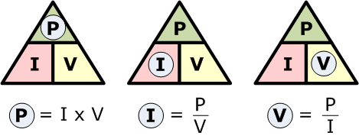
Choosing your power supply
Determine how much wattage you need

Slide 8
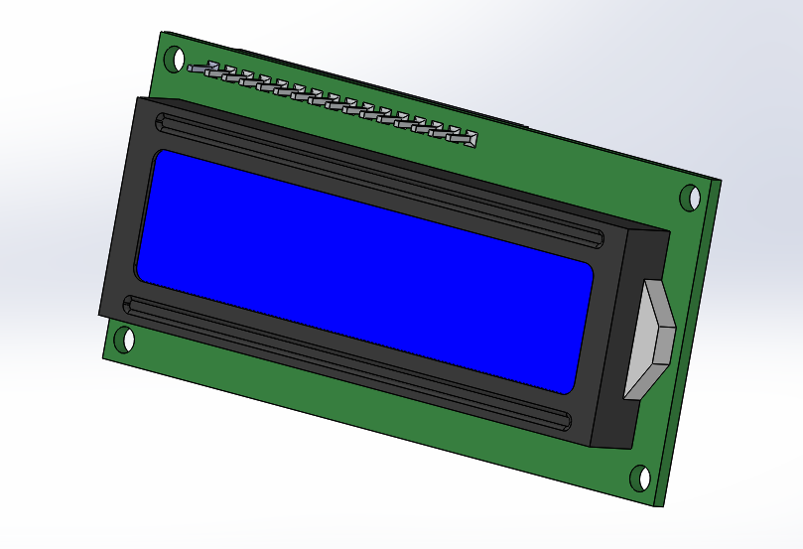
LCD SCREEN
A liquid-crystal display (LCD) is a flat-panel display to produce a visible image.
LCD are super-thin technology display screen that are generally used in laptop computer screen, TVs, cell phones and portable video games
16×2 LCD Display

Slide 9
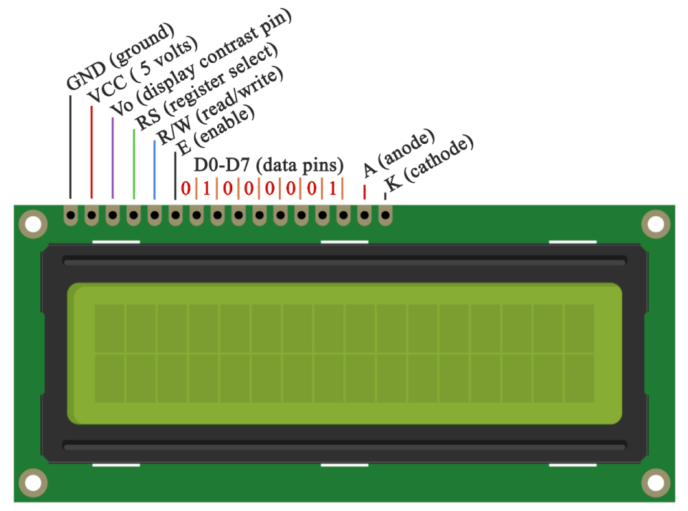
Liquid crystal display
Visual display used in electronic devices
Displays Alphanumeric Symbols
Low Power Display
Operating Voltage: 5 VDC
DISPLAY: 16x2 Characters
Pinout of LCD Screen

Slide 10
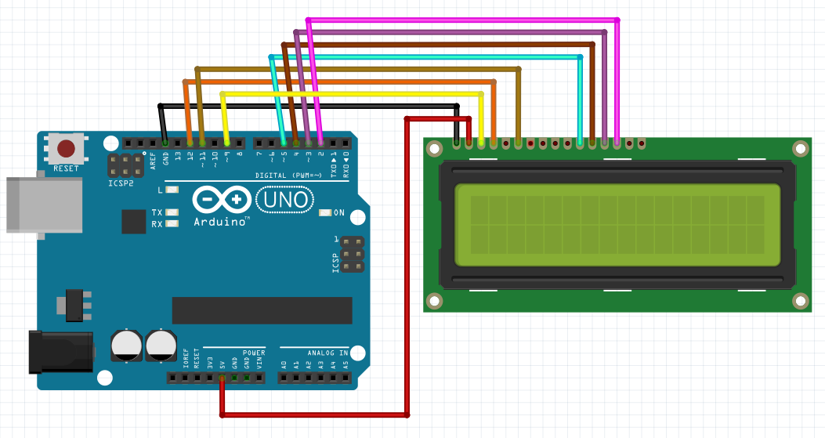
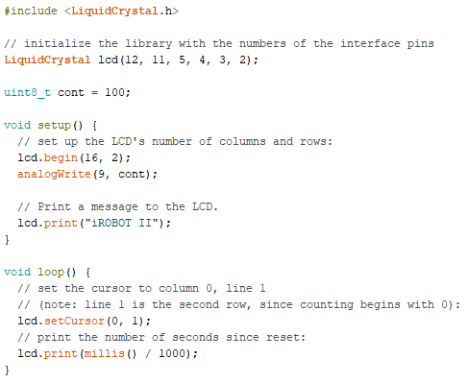
Test code
*LiquidCrystal.h Library used is the standard library in Arduino IDE
LCD Screen connection to Arduino Uno

Slide 11
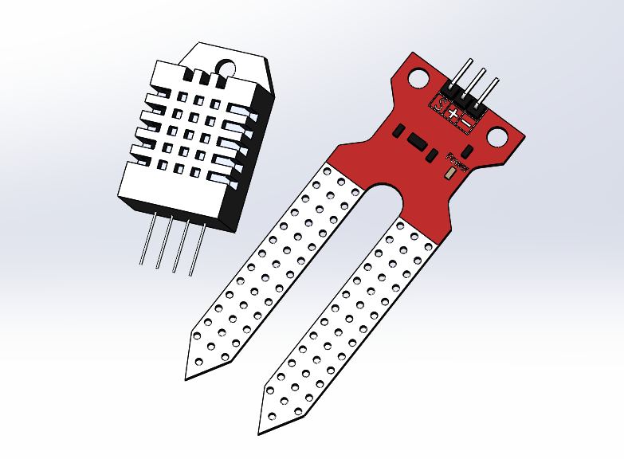
SENSORS
Sensors are sophisticated devices that are frequently used to detect and respond to electrical or optical signals.
A Sensor converts the physical parameter (for example: temperature, blood pressure, humidity, speed, etc.) into a signal which can be measured electrically.
Electrical signals can be interpreted by processors for humans to read
DHT22 Digital Sensor & Soil Moisture Sensor

Slide 12
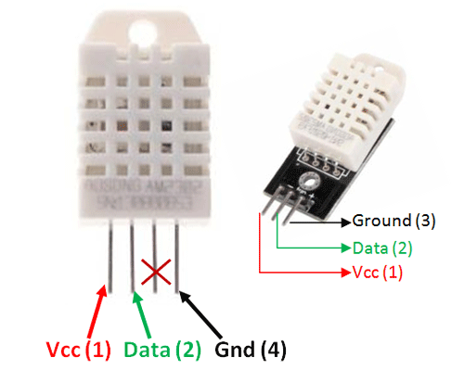
Dht22 Digital temperature and humidity sensor
Supply voltage: 5V
Output voltage: 0-3.3V
Temperature range:-40-80℃ resolution0.1℃ error <±0.5℃
Humidity range:0-100%RH resolution0.1%RH error±2%RH
Includes a capacitive sensor wet components and a high-precision temperature measurement devices
Standard single-bus interface, system integration quick and easy
signal transmission distance up to 20 meters, making it the best choice of all kinds of applications and even the most demanding applications
Pinout of DHT22

Slide 13
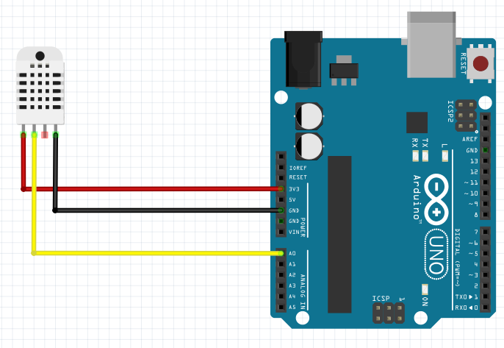
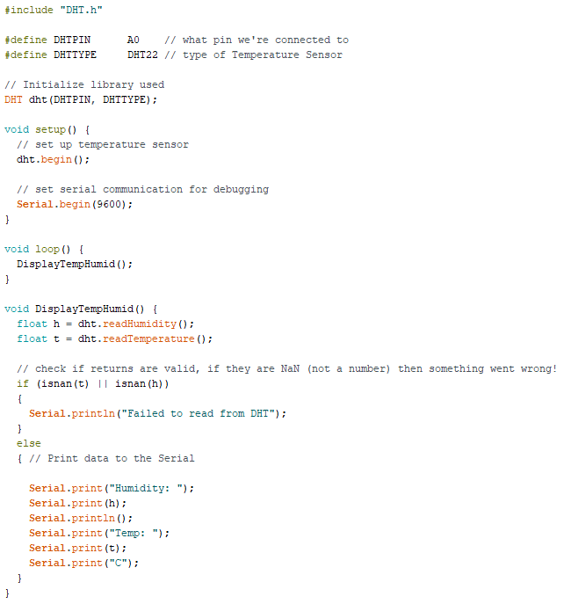
Test Code
DHT22 connection to Arduino Uno
*DHT.h Library used is from Seed Studio Grove Temperature And Humidity Sensor

Slide 14
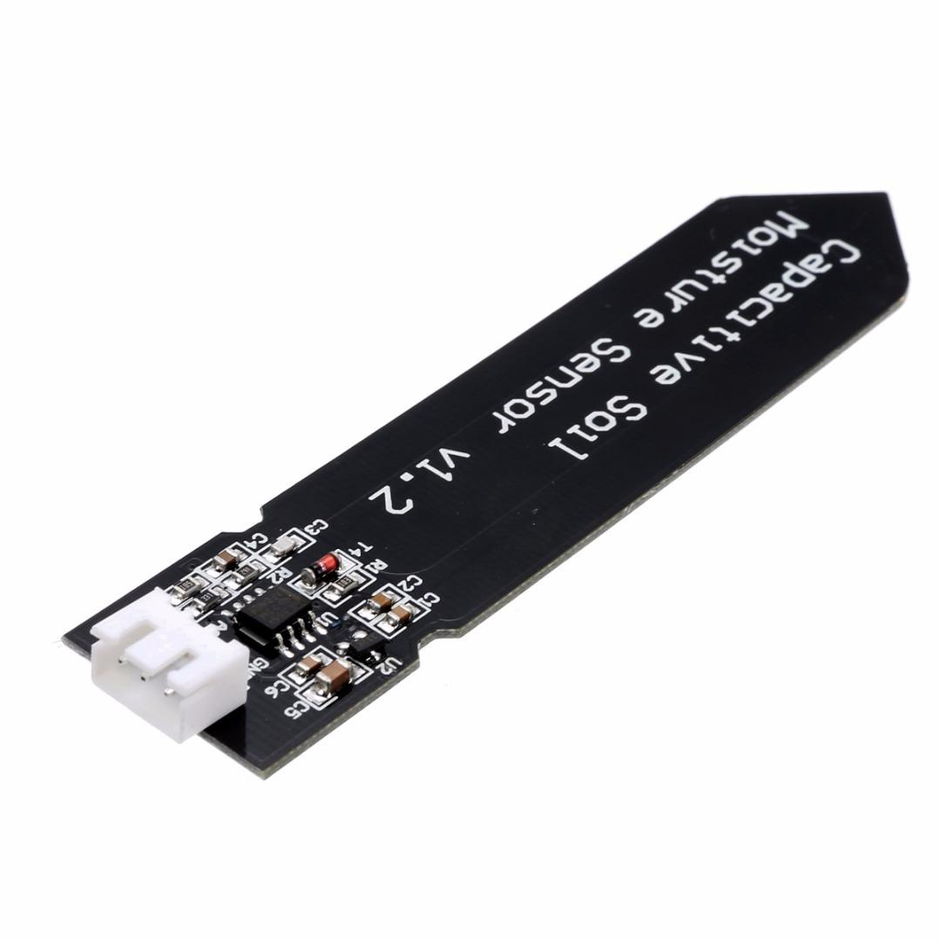
Soil Moisture sensor
Operating Voltage: 3.3 ~ 5.5 VDC
Output Voltage: 0 ~ 3.0VDC
Operating Current: 5mA
Our soil moisture sensor measures soil moisture levels by capacitive sensing
Made of corrosion resistant material which gives it an excellent service life
SIG
VCC
GND
Pinout of Capacitive Soil Sensor

Slide 15
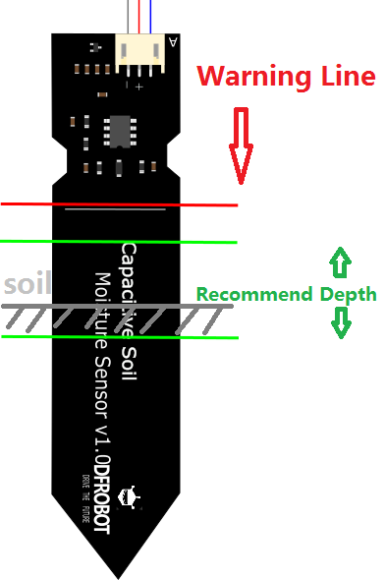
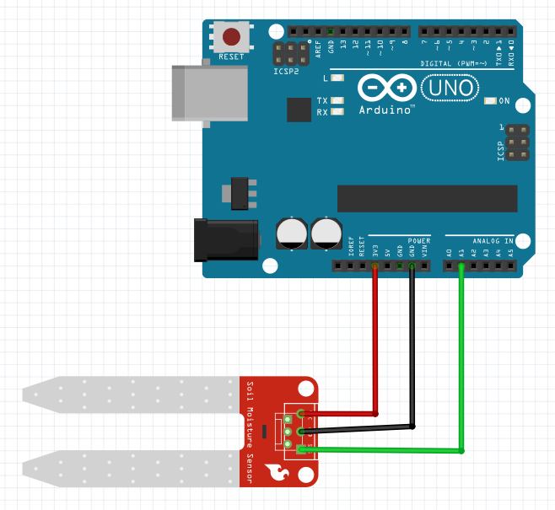
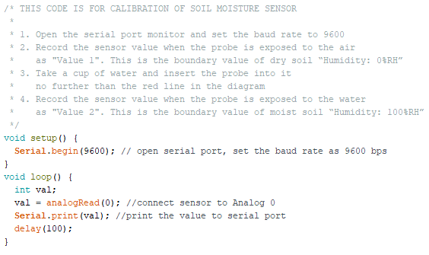
Calibration Test Code
Soil Moisture Sensor connection to Arduino Uno

Slide 16
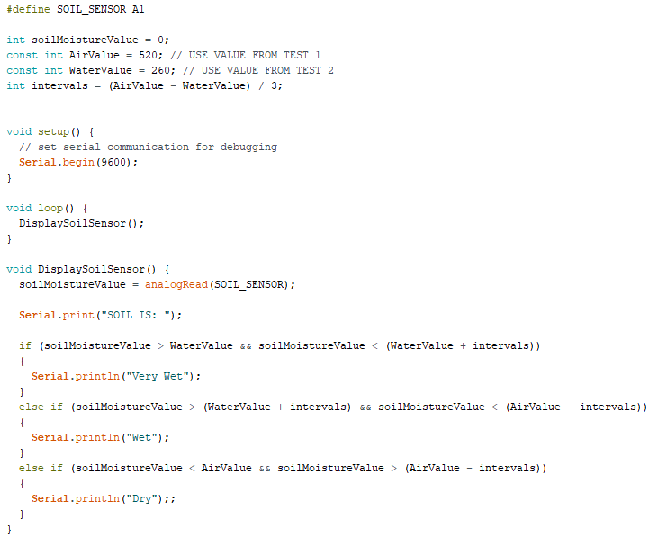
Test Code 2
Soil Moisture Sensor connection to Arduino Uno

Slide 17
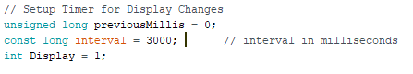
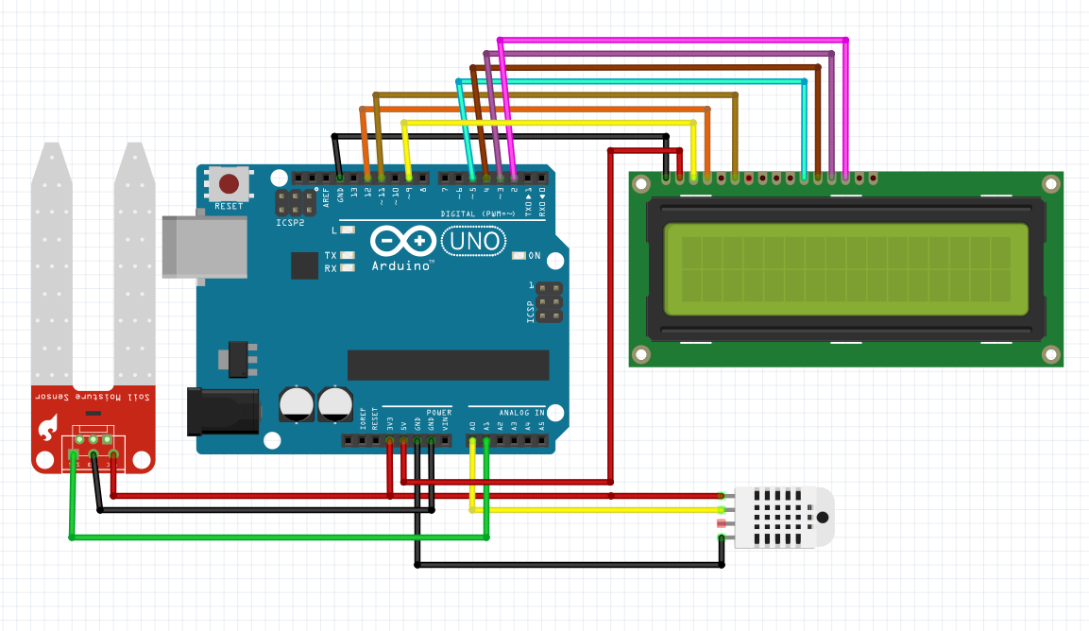
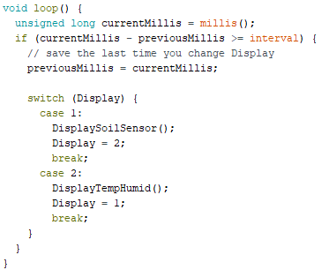
System integration

Slide 18
Sources
[1] Arduino LCD Tutorial https://howtomechatronics.com/tutorials/arduino/lcd-tutorial/
[2] Basic DC Power Supply Circuit https://engineeringtutorial.com/basic-dc-power-supply-circuit/
[3] Sensors: Different Types of Sensors https://www.engineersgarage.com/articles/sensors
[4] DFRobot Soil Moisture Sensor https://wiki.dfrobot.com/Capacitive_Soil_Moisture_Sensor_SKU_SEN0193

Slide 19

Contact details
https://github.com/ronsigter/Tumetechnic
Ronchester.Mendoza@gmail.com

